Slide 1

EColorRace
Lucile Szpiro
Cécile Crapart
Régine Roncucci
Floriane Coulmance--Gayrard

Slide 2



Fluorescence expression GFP or RFP in E.coli costs energy
RFP
GFP
membrane
DEPENDING ON
STRAINS
cytoplasm
mithochondrion

Slide 3

Different media influence molecular synthesis in E.coli
energy
Rich media LB
Media Minimum M9

Slide 4
Who between starving E. coli and satiated ones is more sensitive to a nutrient gradient ?

Slide 5


Prepare E.coli cultures and controls
overnight culture
negative control
X 2
X 2
25mL water
0,3% agar
25mL water
0,3% agar
LB M9
E.coli
X 5
X 5

Slide 6
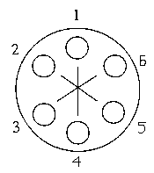


Using plate gradient to compare starving and satiated E.coli
X 5
12,5mL LB
12,5mL water
0,3% agar
X 5

Slide 7
Collect data automatically using our robot

Slide 8
X 2
How RFP respond to a nutrient gradient over time ?
M9
GFP

Slide 9
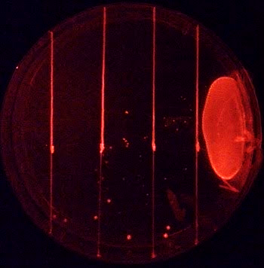
Determine severals plate areas to collect data
5
4
3
2
1
LB nutrient gradient
5 ≠ areas
T1 = 15h
T2 = 23h
T3 = 40h

Slide 10
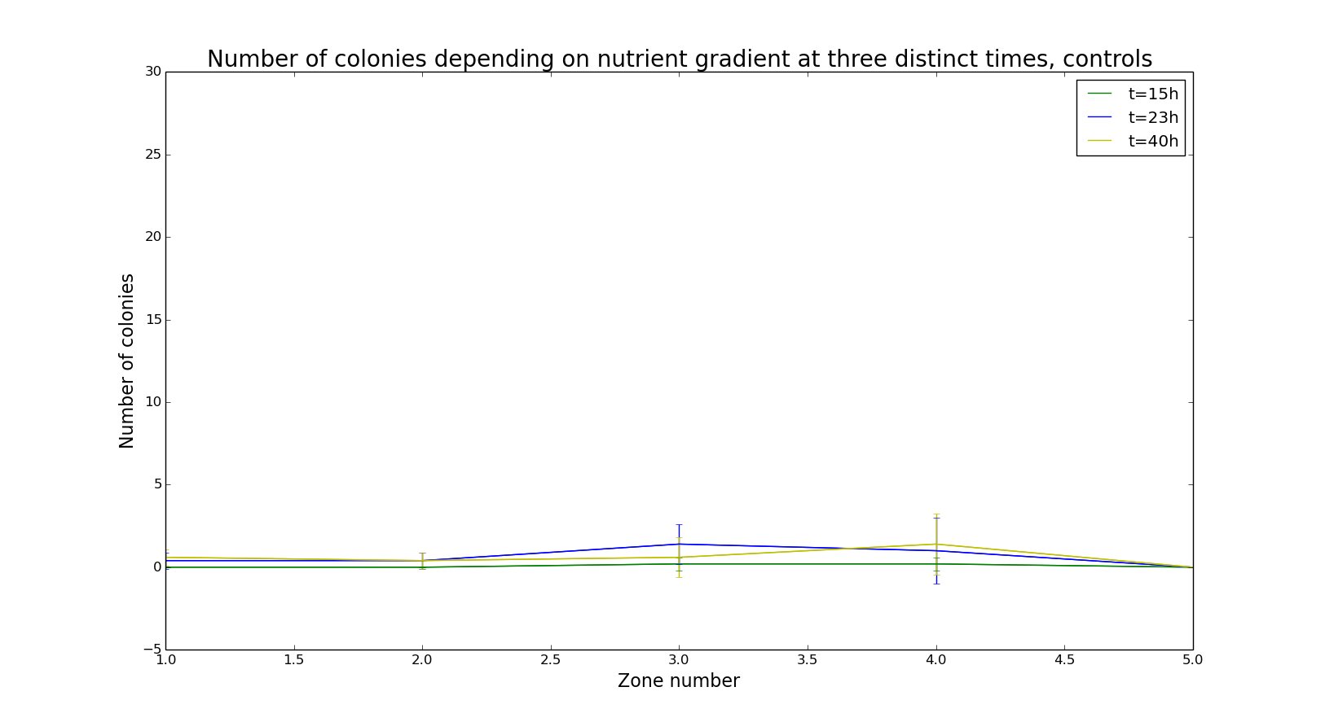
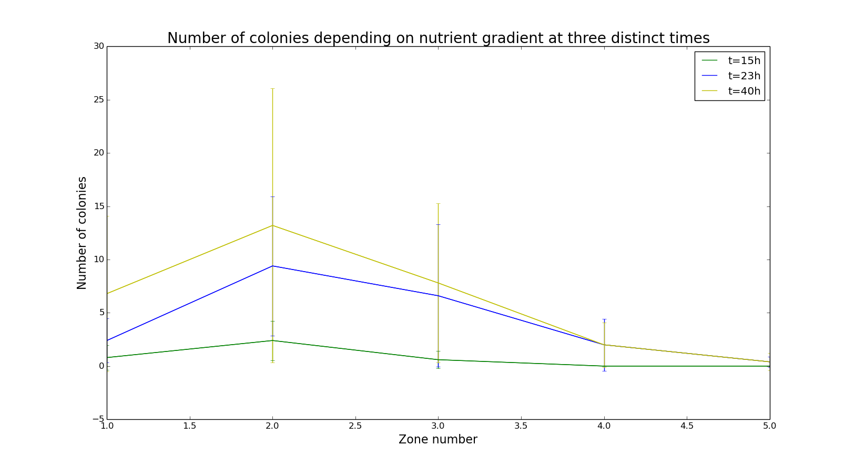
Number of colonies by area doesn’t evolve throug gradient

Slide 11
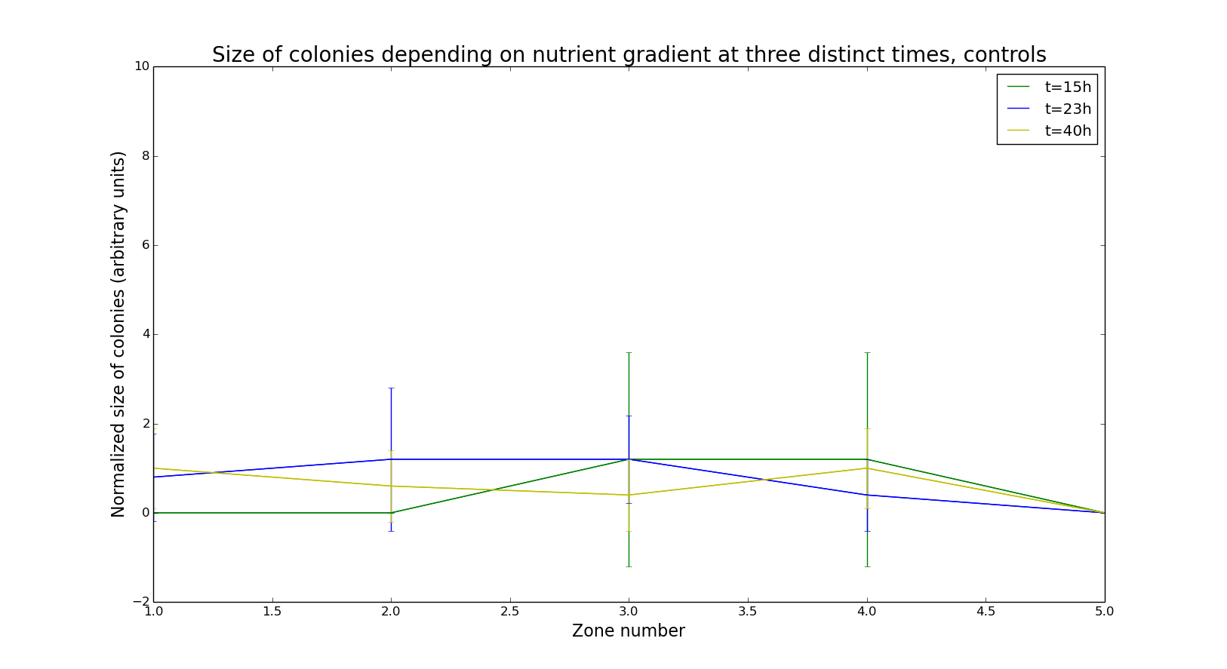
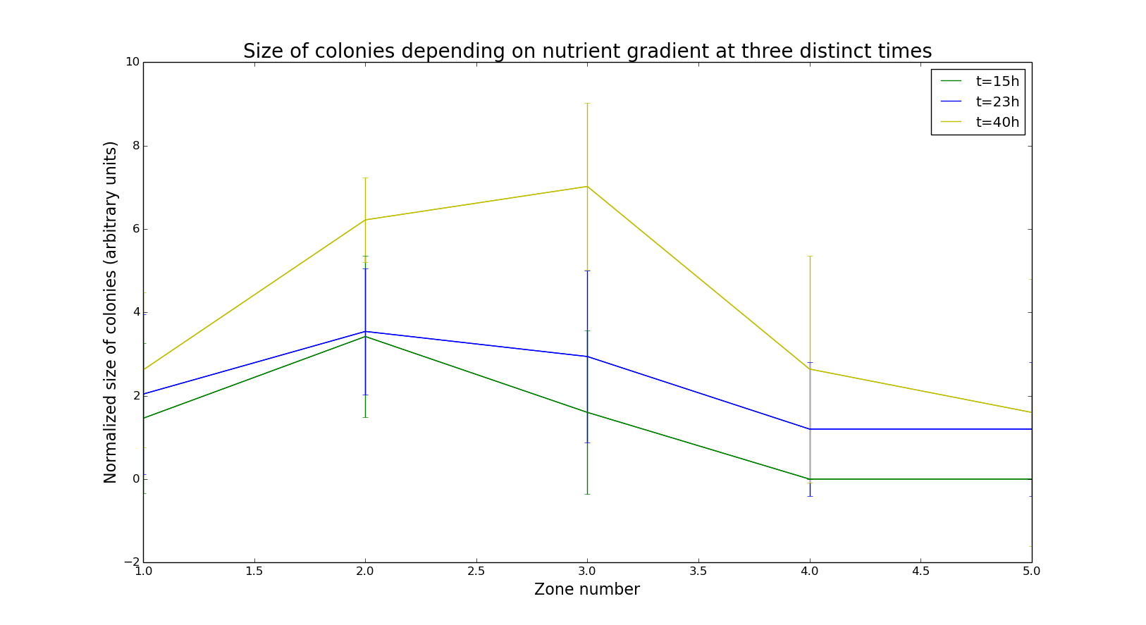
Colony size depends on the gradient

Slide 12
Analysing our data thanks to a new rating
Coefficent response to the gradient
Σ area² number of colonies size of colonies

Slide 13
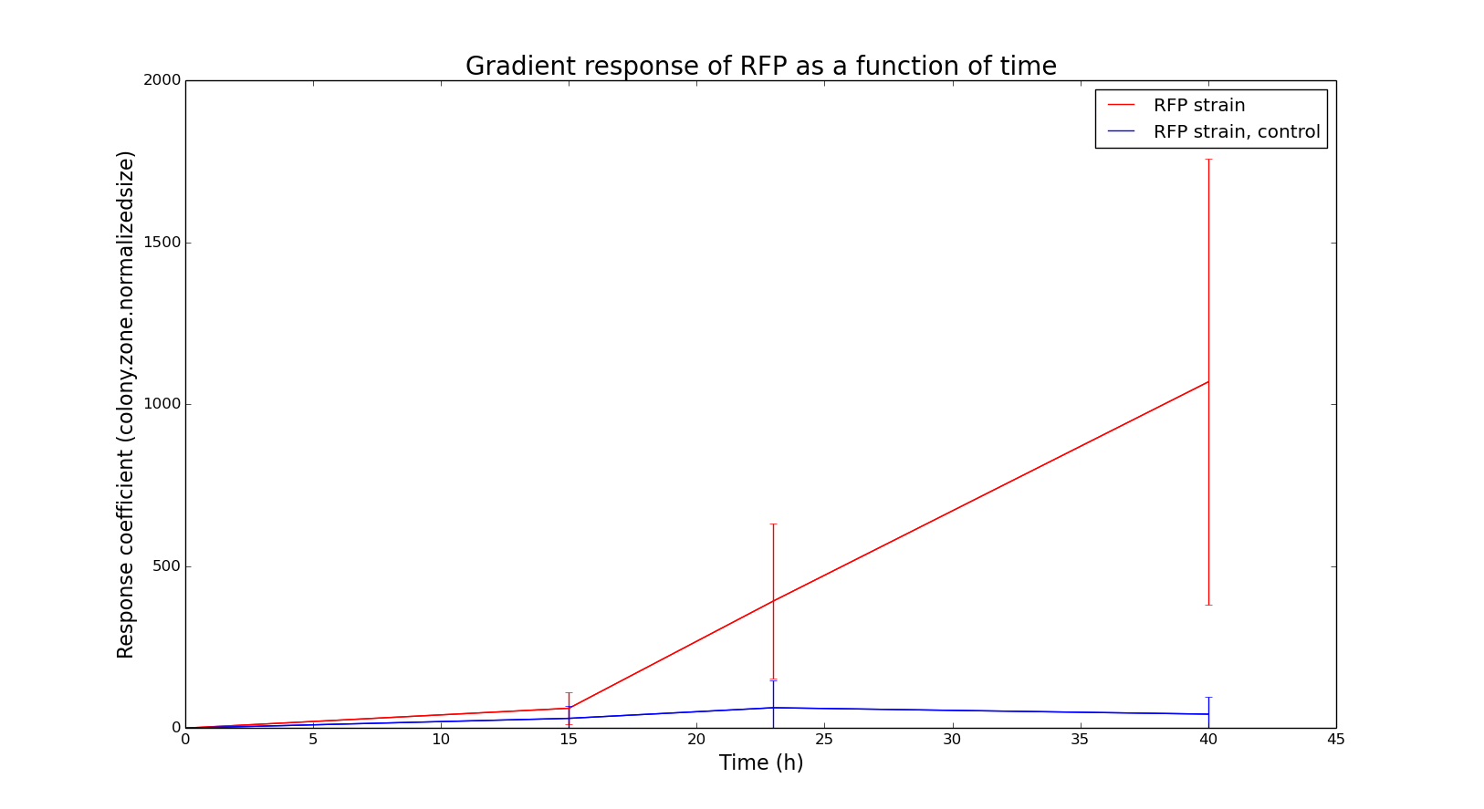
E. coli respond to a gradient

Slide 14
No possible winner because of experimental mistakes
→ RFP E.coli response to a nutrient gradient
→ Highest number of colonies in area 2
→ No more motility when there is enought nutrients
→ Size increases over time
nutrient
gradient
controls
12,5mL water 0,3% agar
LB

Slide 15
Do interactions between ≠ E.coli influence their gradient response ?
R+ RFP E.coli grown in LB
R- RFP E.coli grown in M9
G+ GFP E.coli grown in LB
G- GFP E.coli grown in M9
nutrient gradient
12,5mL water 0,3% agar
12,5mL LB
R- G+
R+ G-
X 5
X 5

Slide 16




Thank you...
Tamara
Aïmen, Ivan
Daniel Kearns
Garage Renault
Le mec de pare-brise
Chantal
Paul-Henry

Slide 17
References
Biologiemarine.com, (2016). Nutrition et croissance des bactéries. [online] Available at: http://www.biologiemarine.com/micro/nutrition.htm [Accessed 12 Feb. 2016].
Pubs.acs.org, (2016). A Simple Method for GFP- and RFP-based Dual Color Single-Molecule Localization Microscopy - ACS Chemical Biology (ACS Publications). [online] Available at: http://pubs.acs.org/doi/abs/10.1021/acschembio.5b00046 [Accessed 12 Feb. 2016].
Thermofisher.com, (2016). Red Fluorescent Protein (RFP) | Thermo Fisher Scientific. [online] Available at: https://www.thermofisher.com/fr/fr/home/life-science/cell-analysis/fluorophores/red-fluorescent-protein.html [Accessed 12 Feb. 2016].
Kearns, D. (2010). A field guide to bacterial swarming motility. Nature Reviews Microbiology, 8(9), pp.634-644.

